Slide 1

Conversion Rate Prediction
Pareekshit Reddy gaddam

Slide 2
Agenda
Introduction
Peek into the Dataset
Feature Extraction and Pre-processing
Modelling and evaluation
Conclusion
Future Work

Slide 3
Introduction
To predict the conversion rate for an online retailer based on the item features.
Conversions in e-commerce are defined as the number of times that a user completes a desired action on the platform.
In this case, the desired action is to purchase a product. Estimating conversion rate is very critical for an online retailer as it impacts many aspects of their business.
For example, the quality of the recommendations, search results and product advertisements they display to their users. We also need to consider that the same user may or may not purchase the product under different circumstances

Slide 4
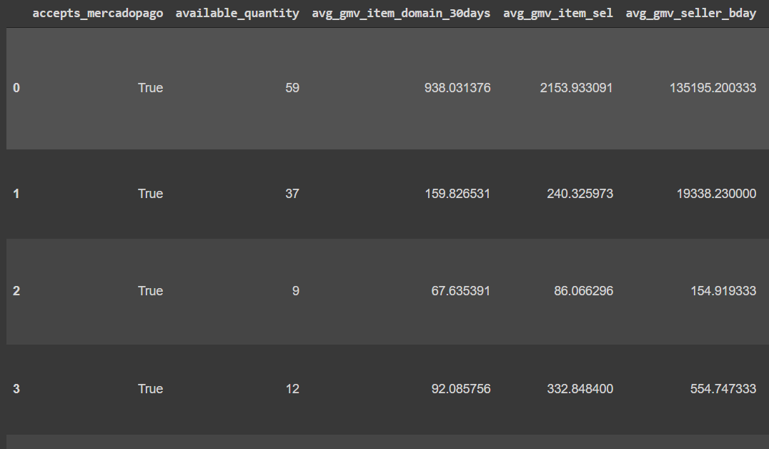
Peek into the Dataset
180761 samples
56 columns
5 – Boolean
33 - Numerical and
18 – categorical variables
The dataset is highly imbalanced, and the target class contains 91% of the FALSE class and only 9% of the TRUE class.

Slide 5
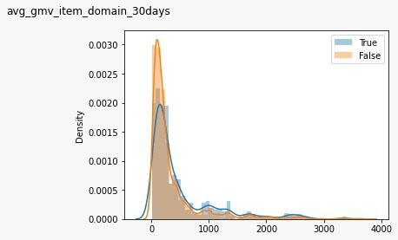
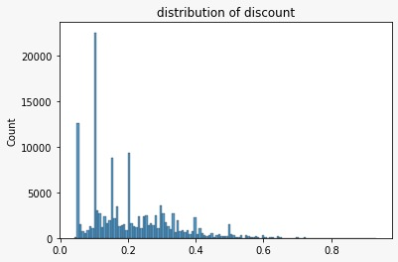
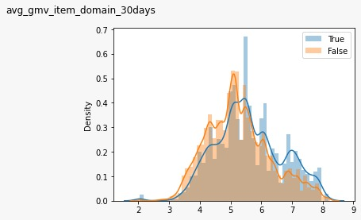
Feature Extraction and Pre-processing
Techniques :
Log Transformation of numeric features (As the data is right skewed).
One hot encoding .
Converting Categorical variables into numeric variables.
Converted these columns to Boolean.
warranty, main_picture
Imputing na’s in numeric columns with mean.

Slide 6
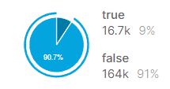
Feature Extraction and Pre-processing
Smote (Oversampling)
Synthetic Minority oversampling technique.
To handle the imbalance in the data we oversample the examples in the minority class.
Smote + TomekLinks.
Fitted Lasso, Light Gradient boosting machines (Feature importance) to select important features.
Plotted Correlation Plots.

Slide 7
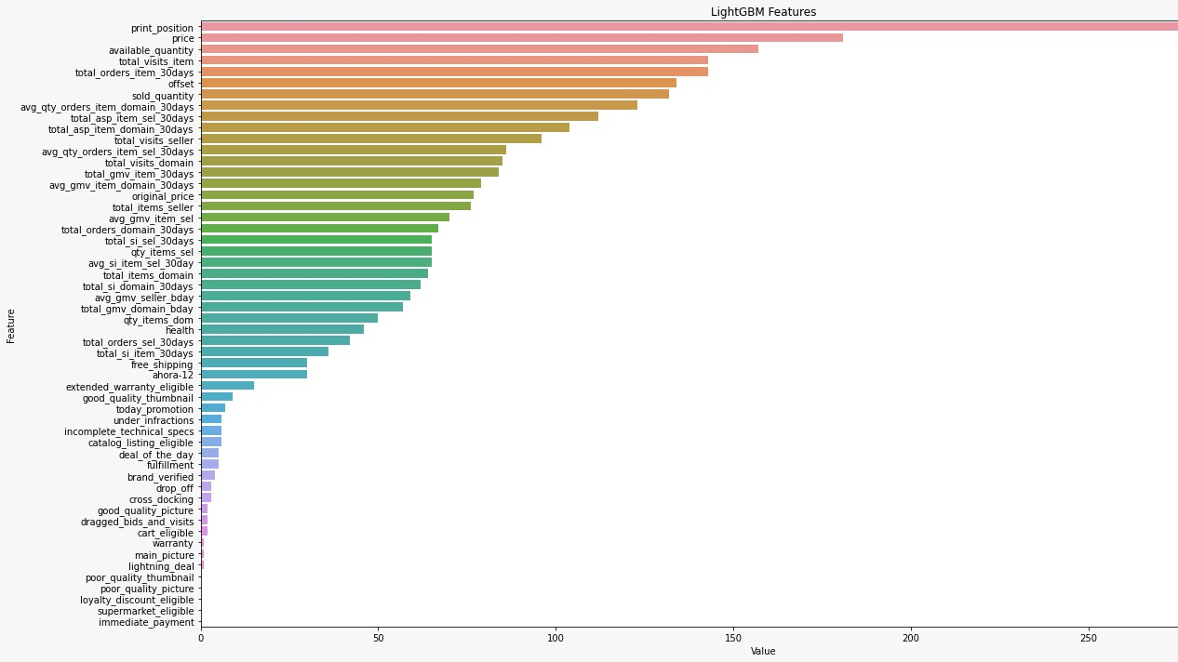
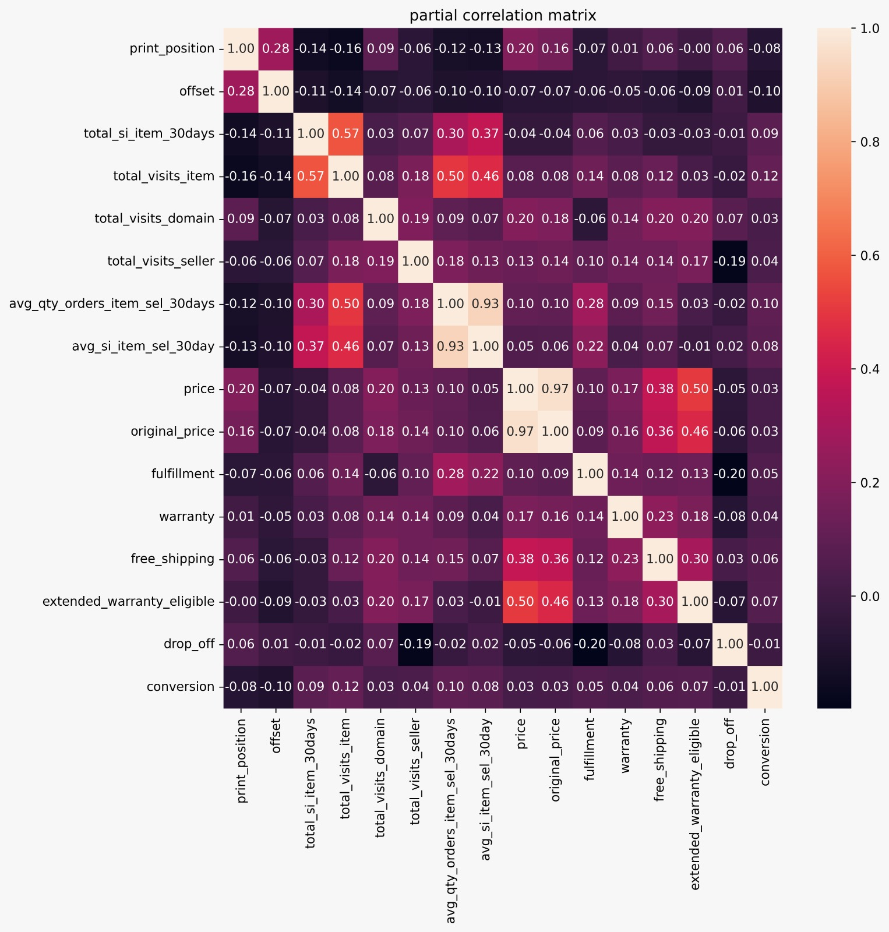
Feature Importance

Slide 8
Modelling and Evaluation
Logistic Regression
Support Vector Machine
Random Forest
Light GBM
XG Boost
Neural Networks

Slide 9
Techniques
Stratified data splitting
Stratified Kfold
Optimal Threshold
Bayesian Optimization
Model stacking
Stepwise selection

Slide 10
Logistic Regression
We have done stratified sampling during the train-test split, to ensure that ratio of samples of the target variable remains same in the train and test splits.
Penalty = ‘L1’
Solver = ‘liblinear’
Class_weight = ‘balanced’
Metrics | Recall Score | ROC_AUC Score
Train | 0.7937 | 0.7321
Test | 0.7026 | 0.7128

Slide 11
Support Vector Classifier
Hyper Parameters:
Penalty='l1’
dual=False
class_weight=’balanced’
C=1.0
max_iter=10000
Metrics | Recall Score | ROC_AUC Score
Train | 0.8286 | 0.7318
Test | 0.7141 | 0.7367

Slide 12
Experiments and Evaluation Random Forest
Hyper Parameters:
n_estimators=200
max_depth=5
class_weight="balanced"
Metrics | Recall Score | ROC_AUC Score
Train | 0.7952 | 0.8112
Test | 0.7445 | 0.7427

Slide 13
LightGBM
Hyper Parameters:
'boost': 'gbdt’,
'bagging_fraction': 0.48,
'bagging_freq': 7,
'feature_fraction': 0.11,
'lambda_l1': 0.07,
'lambda_l2': 0.03,
'learning_rate': 0.005,
'max_depth': 21,
'min_data_in_leaf': 66,
'num_leaves': 650
Metrics | Recall Score | ROC_AUC Score
Train | 0.9234 | 0.8218
Test | 0.8928 | 0.7754

Slide 14
XGBoost
Hyper Parameters:
objective="binary:logistic”
n_estimators=1000
scale_pos_weight=10
subsample = 0.8
colsample_bytree= 0.8
learning_rate= 0.09
max_depth= 5
early_stopping_rounds=40
Metrics | Recall Score | ROC_AUC Score
Train | 0.8527 | 0.8668
Test | 0.7245 | 0.8052

Slide 15
Neural network
Hyper Parameters:
Optimizers: Adam
Decay_rate: 0.0000001
Activation functions: relu, sigmoid
L2 regularization
0.001 - penalty
Drop out 0.2
Initializer = random_normal
Metrics | Recall Score | ROC_AUC Score
Train | 0.8021 | 0.8067
Test | 0.7168 | 0.7613

Slide 16
Conclusion
XGBoost performs better among all these models.
Ensembling XGBoost model and LightGBM model gives us a better result with 0.8176 AUC.
Relative to all models, Logistic regression performs worst.

Slide 17

THANK YOU

